Slide 1
Method Overloading In Java
momedaram

Slide 2
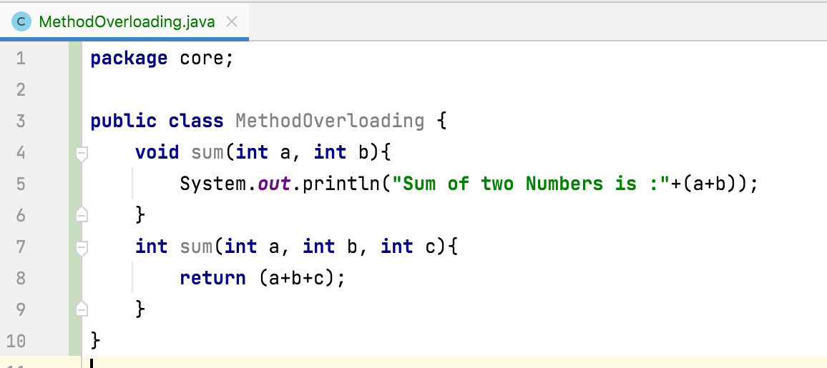
What is Method Overloading in Java
If a class has more than one method with same name, different number of arguments or different types of arguments then we call that method is overloaded.

Slide 3
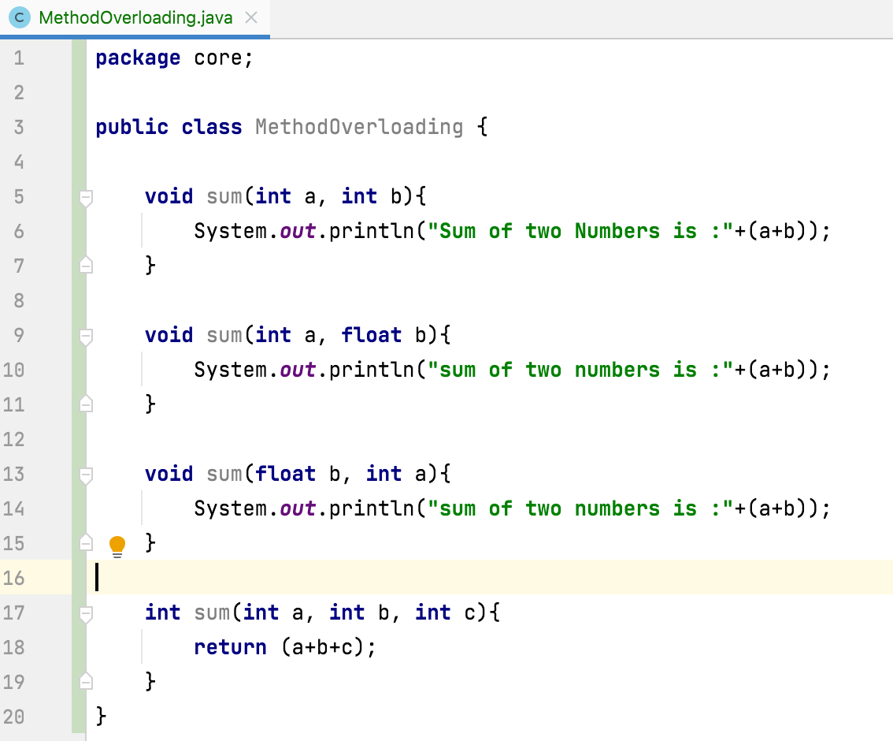
Compiler checks method signature for duplicate methods.
method signature consist of three things:
Method Name
Number Of Arguments
Types of arguments

Slide 4
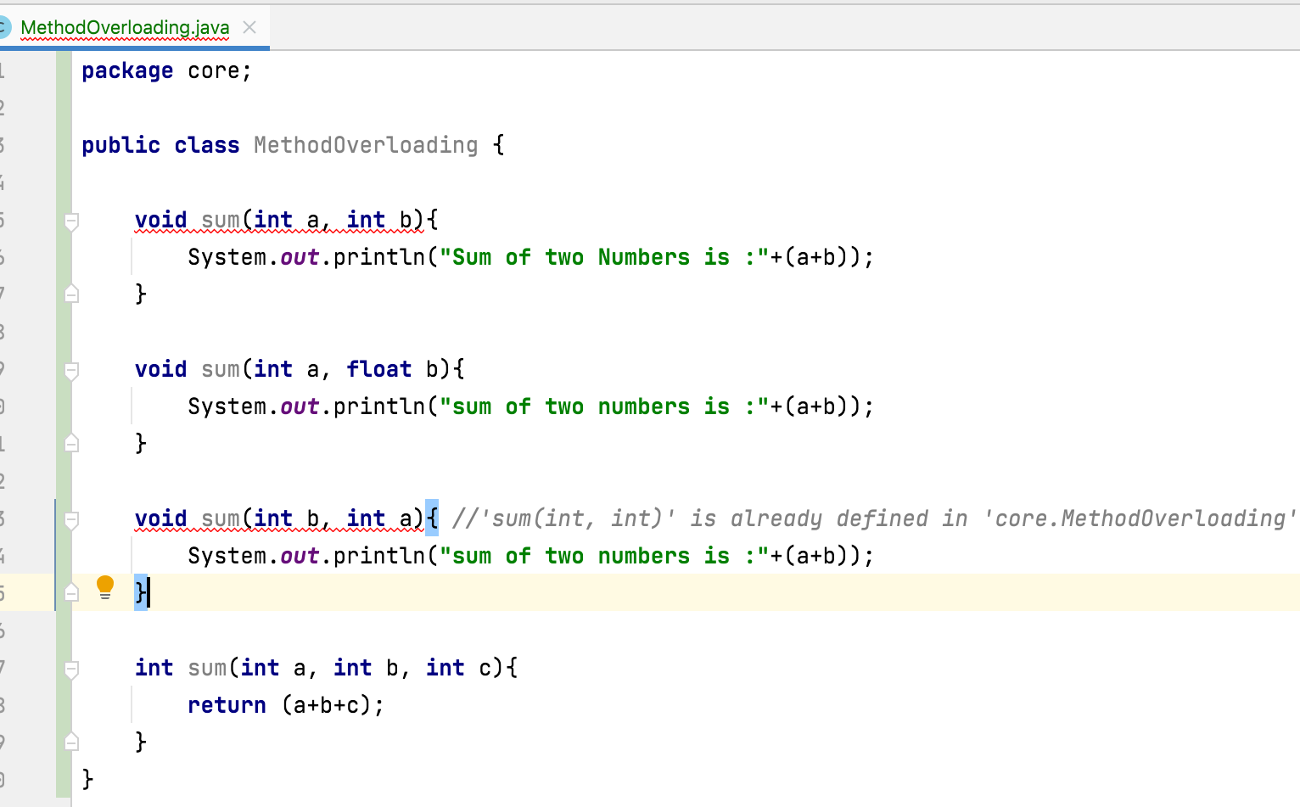

Slide 5
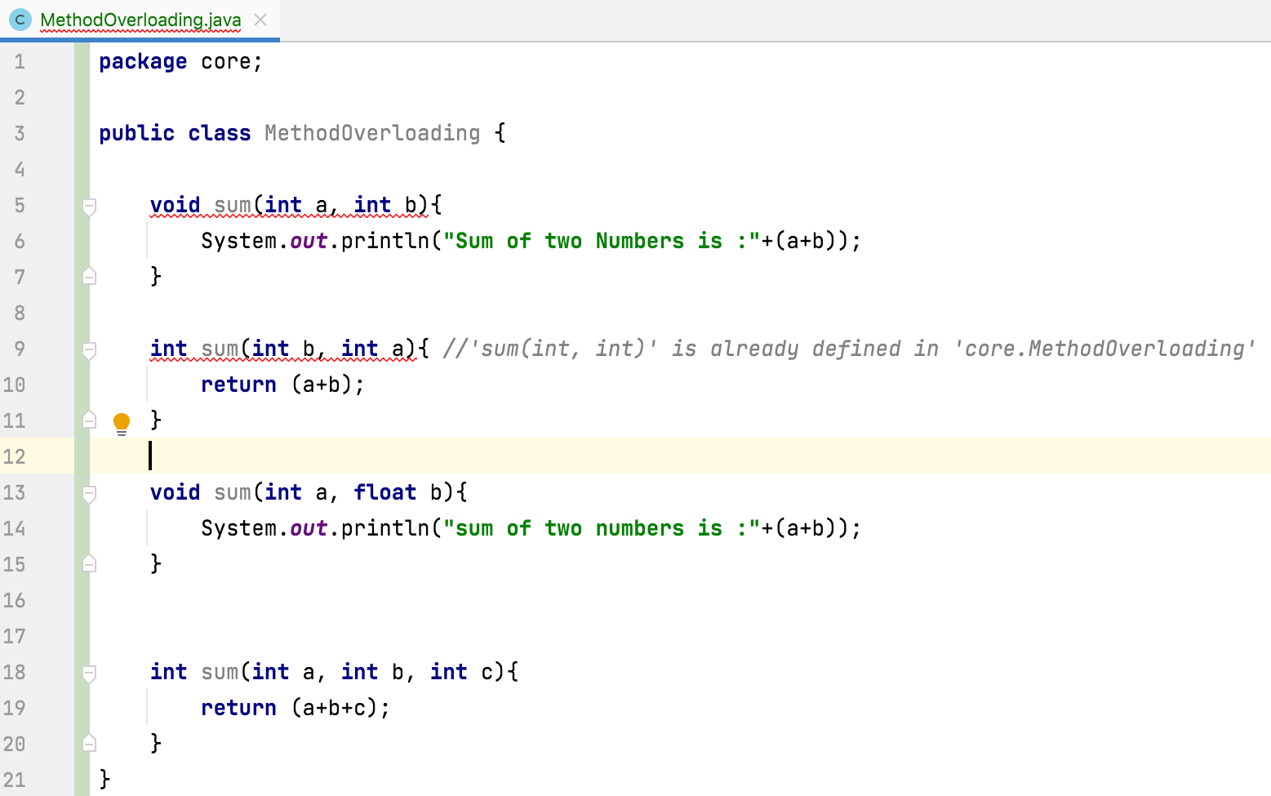
If two methods have same signature and different return types, then those methods will not be treated as two different methods or methods overloaded

Slide 6
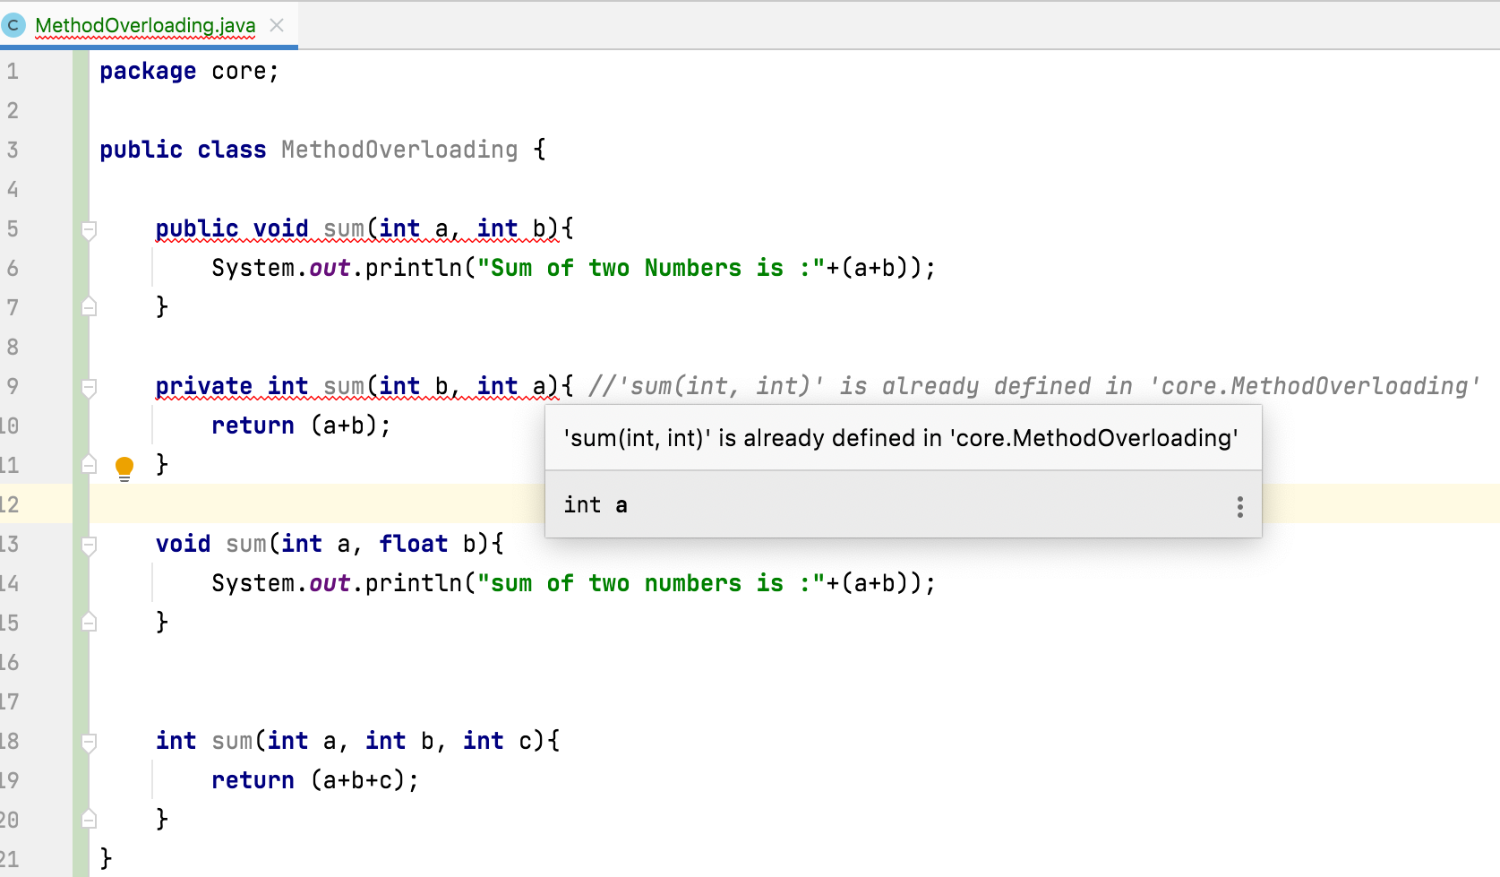
If two methods have same signature and different access modifiers, then those methods will not be treated as two different methods or methods overloaded

Slide 7
Compiler will check only method signature for method overloading or for duplicate methods. It does not check return types, access modifiers and static or non-static.

Slide 8
Thank You !
momedaram

